Slide 1

JobGet

Slide 2
SKELETON PLANE
Once the Interaction Design and the Information Architecture is designed in the Structure Plane ,the functionality component is added in the Skeleton Plane
Three important components are designed here:
Interface Design
Navigation Design
Information Design

Slide 3
SKELETON PLANE
INTERFACE DESIGN
The essential interface elements that make up the UI are chosen and arranged in this design phase
This includes the design of primary buttons, text fields and the white spaces that can be deliberately used to make the screen look clutter free etc.
In our project we chose on where the various elements will be placed and designed the components to give a consistent look and feel

Slide 4
SKELETON PLANE
NAVIGATION DESIGN
In this design the links to various pages in the interface design are made to ensure smooth navigation throughout the application
The navigation links are built in such a way such that the information between the relevant pages are linked in order.
In our project, an existing user can log in and move to his personalized home page or a new user can sign up and easily navigate through pages using the navigation bar, buttons etc.

Slide 5
SKELETON PLANE
INFORMATION DESIGN
In this design , the content that the site deals with is laid out based on the way we want the user to navigate across the pages of the site.
In our project, an existing user has the provision of having going through his personalized content throughout the application.

Slide 6
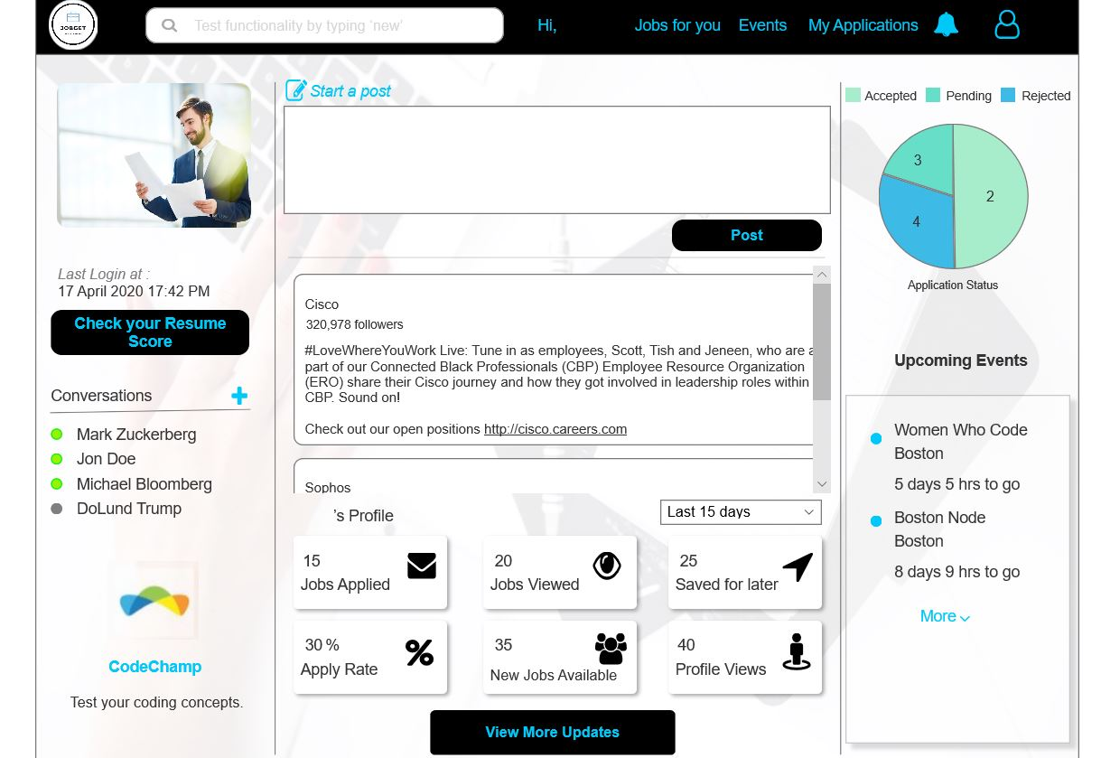

Slide 7
SURFACE PLANE
This is the top most plane where the visual presentation of the site is looked into
All the content from the skeleton plane is arranged in a way such that it makes the content of the website relevant and serves user needs
Various aspects of Sensory Design is incorporated in the project which include concepts of Google Material Design,Google Material Icons and effective Typography .
SENSORY DESIGN
“ Picture is worth a thousand words”

Slide 8


Slide 9
Google Material Design
Google Material Design is a visual language that synthesizes the classic principles of good design with innovation of technology and science which help our application for conforming to the norms of a uniform User Interface design highlighting each essential aspect of the product design.
Uniformity: An overall uniform presentation of background content is used so that any user while navigating from one screen to another sees that the content is uniform and more focused on the information the user is looking for.
Bold Graphic, Intentional : 3-4 colors have been used throughout the application and headings, buttons, popups and important information have been bold and has a uniform size of 24 or 28 with color #00C8F8
Brand Identity : We have used Google material icons and UI patterns which gives it a brand identity and adheres to uniformity. Usage of appropriate icon, font and color have helped us achieve a uniform logo
Google Material icons, UI patterns, calendar picker, time picker, input stepper, charts, pop up boxes, radio button groups, labels etc. have been used throughout the application

Slide 10
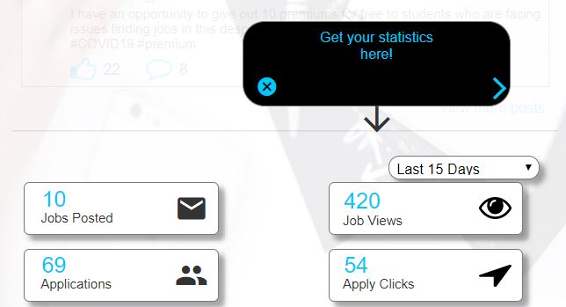
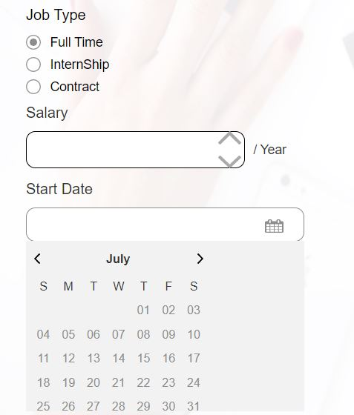
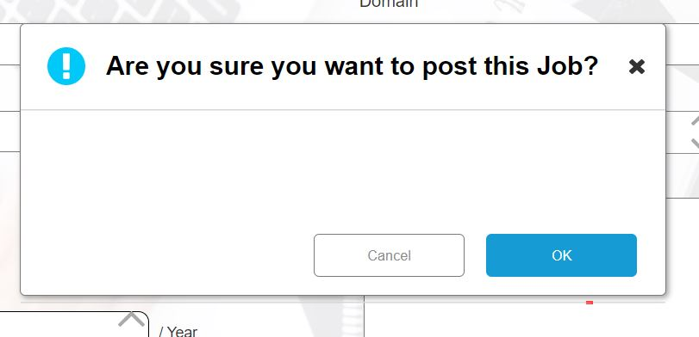

Slide 11
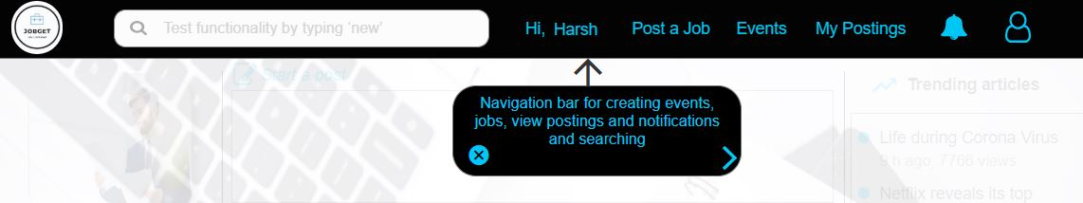
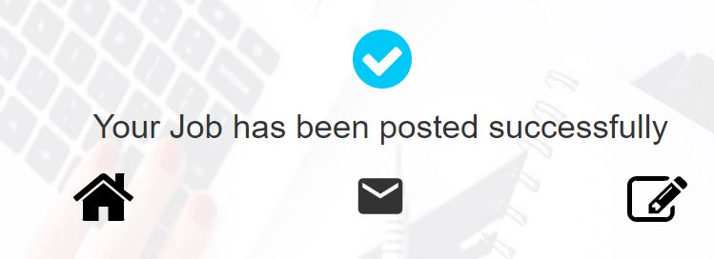
Screenshots

Slide 12
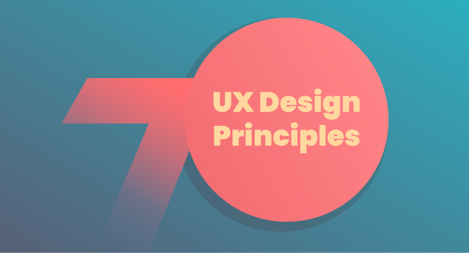

Slide 13
Meet the users’ needs
The term user experience denotes that your work needs to center around user’s experience with your application or service. Thus we learned about what users wanted in the design by user testing and
designed and placed the right components at the right place.
Have a clear hierarchy
Having smooth navigation throughout the application is often taken for granted, but to offer a smooth and good user experience, having a clear hierarchy is of high priority and is often neglected. If the navigation is not smooth or is confusing, users are often put off by it. Having a navigation bar with the correct information is essential
Keep it consistent
Keeping the design consistent with similar products already present in the market enhances the user experience as they do not have to invest time in adapting to the application and it is also easier for the developers as they do not have to build something new every time

Slide 14
Less is more
The simpler the design, it serves a better user experience and seems easy and consistent to use as compared to over decoration in size which leads to an unpleasant experience
Feedback matters
The application design should be interactive i.e. when a user clicks or performs a task, the application should generate a response for the users to understand that the task has been performed. We have incorporated dialog popups, success screens and messages or change in icons in JobGet
Use simple language
The content writers should avoid using technical and complex terms, using words closest to the user’s thoughts in design as users are multi tasking and this will help in enhancing the user experience
The user is in control
User control focuses on greater flexibility of use and better control of where a user is within a design or product, enhancing user experience. Furthermore, it allows users to backpedal and recover from errors which gives a lot of control to the user.

Slide 15
Manual Testing*
*Refer a Document File

Slide 16
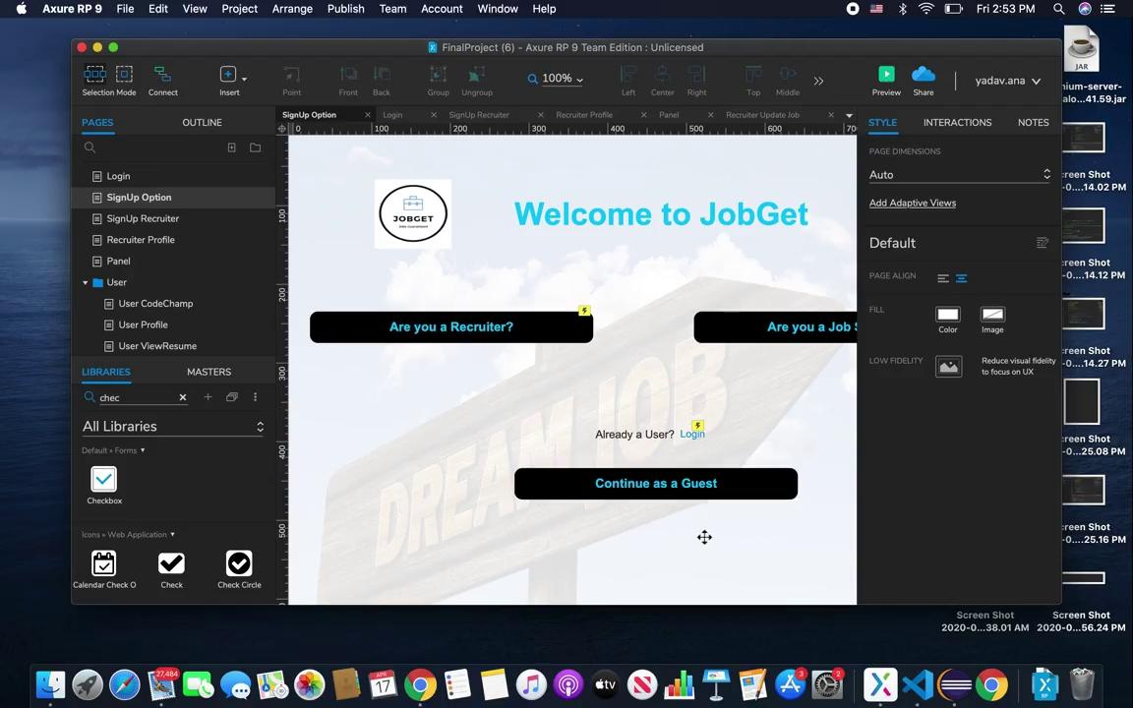
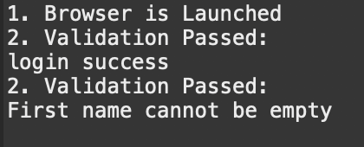
Selenium Automation Testing Results

Slide 17
UX RESEARCH METHODS

Slide 18
SURVEY AND QUESTIONNAIRES
https://docs.google.com/forms/d/1ycThLUwEqov3U-J6_TMG1V-SLmhGwKHMKOexjITGWE4/edit

Slide 19
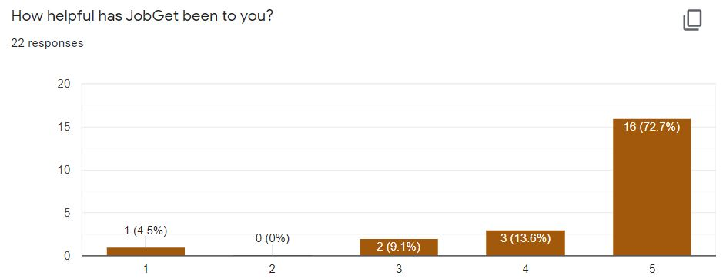
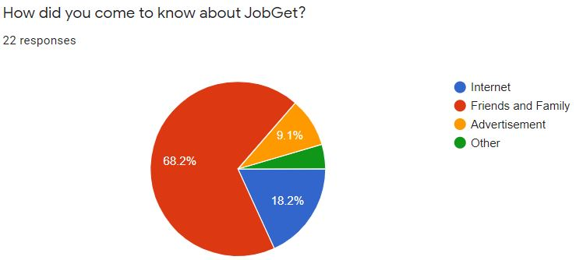
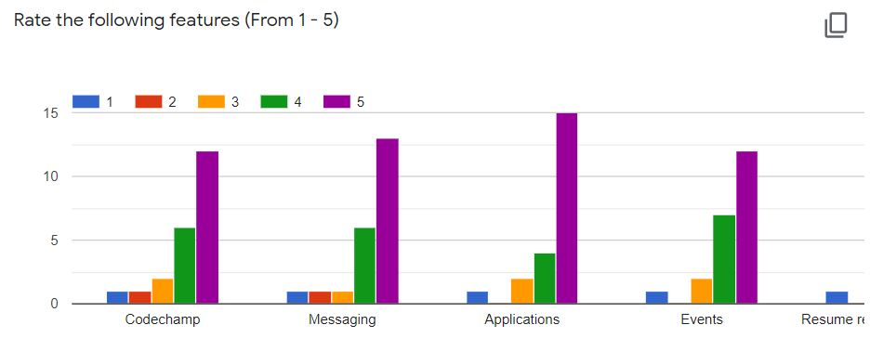
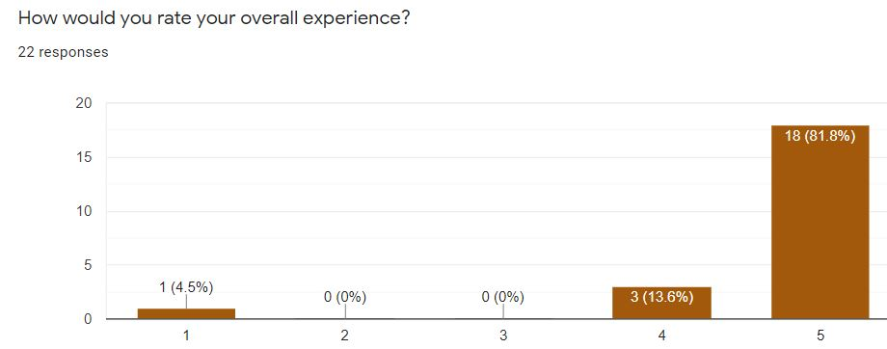
Responses
01
03
02

Slide 20
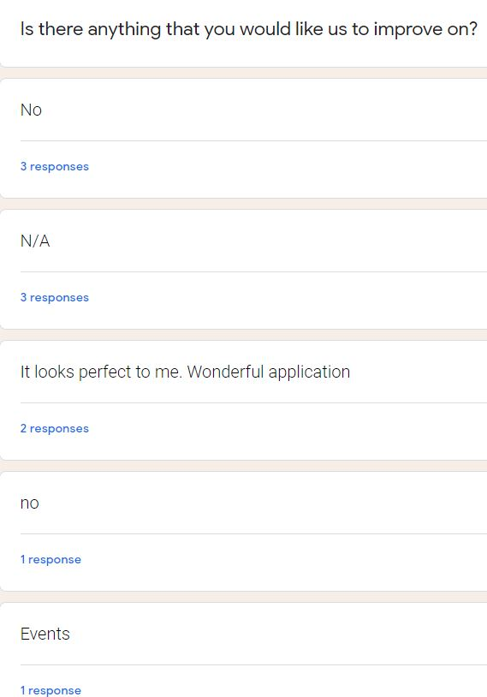
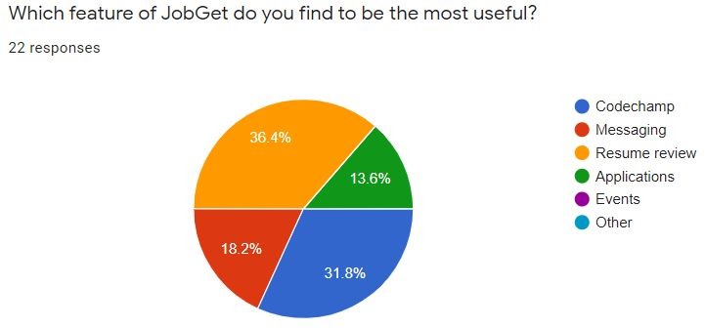
Responses
01
03
02

Slide 21
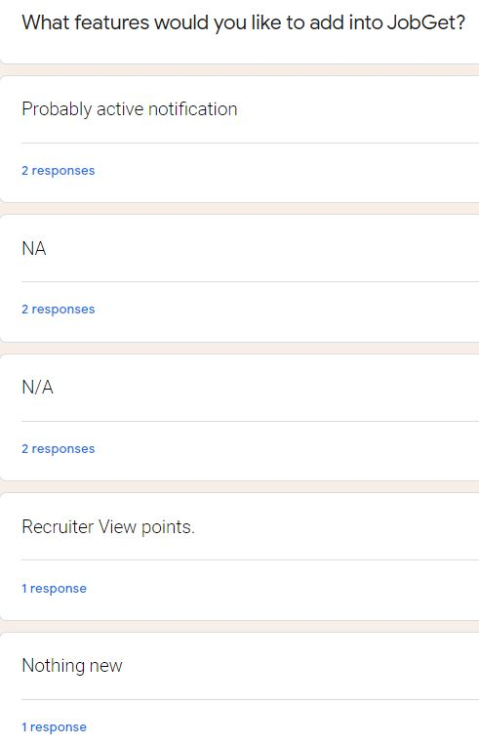
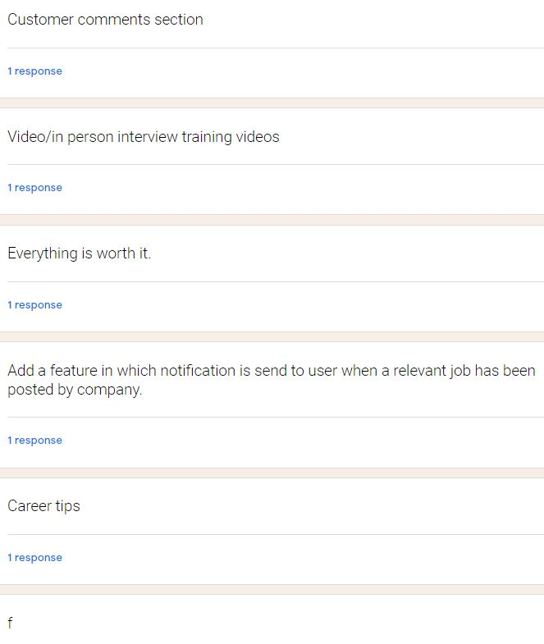
Responses
01
03
02

Slide 22
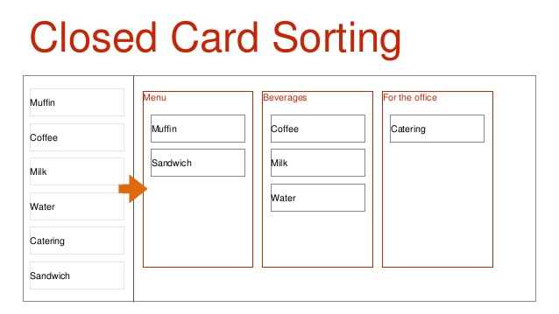
Card Sorting
Card sorting helped us understand our user’s expectations and understanding of our application and helped us build the structure of the application, what should go on the home page, what should be on the navigation bar and the navigation
We used closed card sorting method where we gave our users a defined and limited set of categories such as postings, search, messaging, profile, user applications, resume etc. and asked them to sort the content in these predefined categories.
We then asked if they thought we should split any category and make it more precise or if we could combine a few categories into one. This lead us to split the postings into jobs, events and a combination of both of them called postings.
We asked a few students to take part in this usability testing method

Slide 23
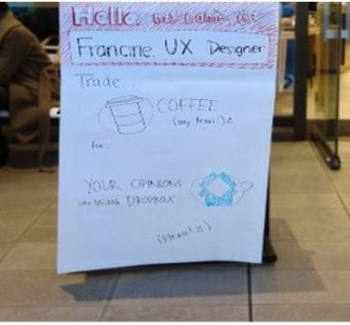
Guerrilla Testing
Guerrilla Testing is a modern, lightweight take on traditional usability testing. Instead of renting a lab, it is typically done outside in the community in coffee shops or in shopping malls and asked to complete a basic test with an application or service in exchange of a few dollars or out of the goodness of the heart
We asked our roommates to use the application and asked questions such as What do you feel about the experience of posting a job and event as a recruiter? How is the overall messaging experience? Do you feel the is overloaded with information? Does the navigation feel right? What features do you think stand out in JobGet? Which application in the market right now would you rate above JobGet? Which is the best feature in the application and which that feature lacking?
It is a good research method for our application as we have a huge target audience but for applications with a small target audience, this wouldn’t be a good method

Slide 24
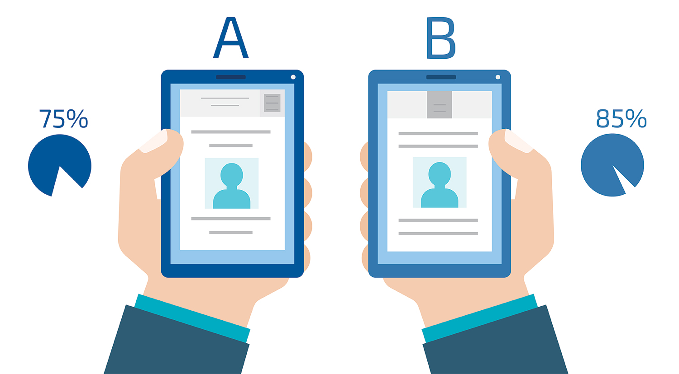
A/B Testing
A/B testing is usually chosen when designers struggle to decide between two competing elements or designs. Whether it is which out of the two buttons should be used or is the earlier home page is better than one recently designed
It involved randomly showing each version to an equal number of users and review analytics on which version better accomplished the specific goal
We faced issues while designing the home page layout of the recruiter as to whether the analytics of the user should be shown in the down centre descriptively or on the top right in a graphical representation
We developed both designs and showed both the designs to an equal number of people which helped us to make that important decision about the design and layout of the homepage

Slide 25
IBM DESIGN THINKING

Slide 26
User Needs
What do you need as a user in an online Job Portal? With the perspective of a Job Seeker, you need to see jobs based on your respective domain, apply for jobs, view events, message recruiters and other user. We jot down all the possible needs of a job seeker. Keeping in mind a recruiter, you jot down and think deep about all the possible needs of the recruiter such as posting jobs in a particular domain, creating events and inviting people, viewing information about the applicants are some of the important user needs
Can it be a all-in-one job portal? Apart from the primary features, what other functionalities could be integrated which would serve important to job seekers and recruiters? Will we be able to implement them in the time frame and with the allocated resources?
The users should be the only focus while designing the application and at every stage, we should have the maximum user participation so that the application can better serve its target audience and the application would be a stand out product

Slide 27
IBM DESIGN THINKING PRINCIPLES
A focus on user outcomes :
It starts with the user i.e. recruiters and job seekers and focusing on their needs and wrap the services and functionalities via the application
Regular efforts should be made by JobGet to change the requirements as per the user requirements and to match the current trends
Multidisciplinary teams :
Moving fast with the trends and the ever-changing user requirements is difficult to achieve with the traditional waterfall processes of incremental design
Multidisciplinary teams like UX, Requirement Gathering, Development, Marketing teams working in unison not only generate better solutions to the user needs but would also account to a foundation of trust

Slide 28
IBM DESIGN THINKING PRINCIPLES
Relentless ReInventions :
At JobGet, everything i.e. even the oldest feature to the newest solutions are considered as a prototype which helps in getting the best solutions to the user needs
Some examples of prototypes which were built due to the relentless inventions are integrating a competitive coding platform, adding a tool that calculates resume score, improvement in the user statistics with incorporating features like sorting statistics with respect to time etc.

Slide 29
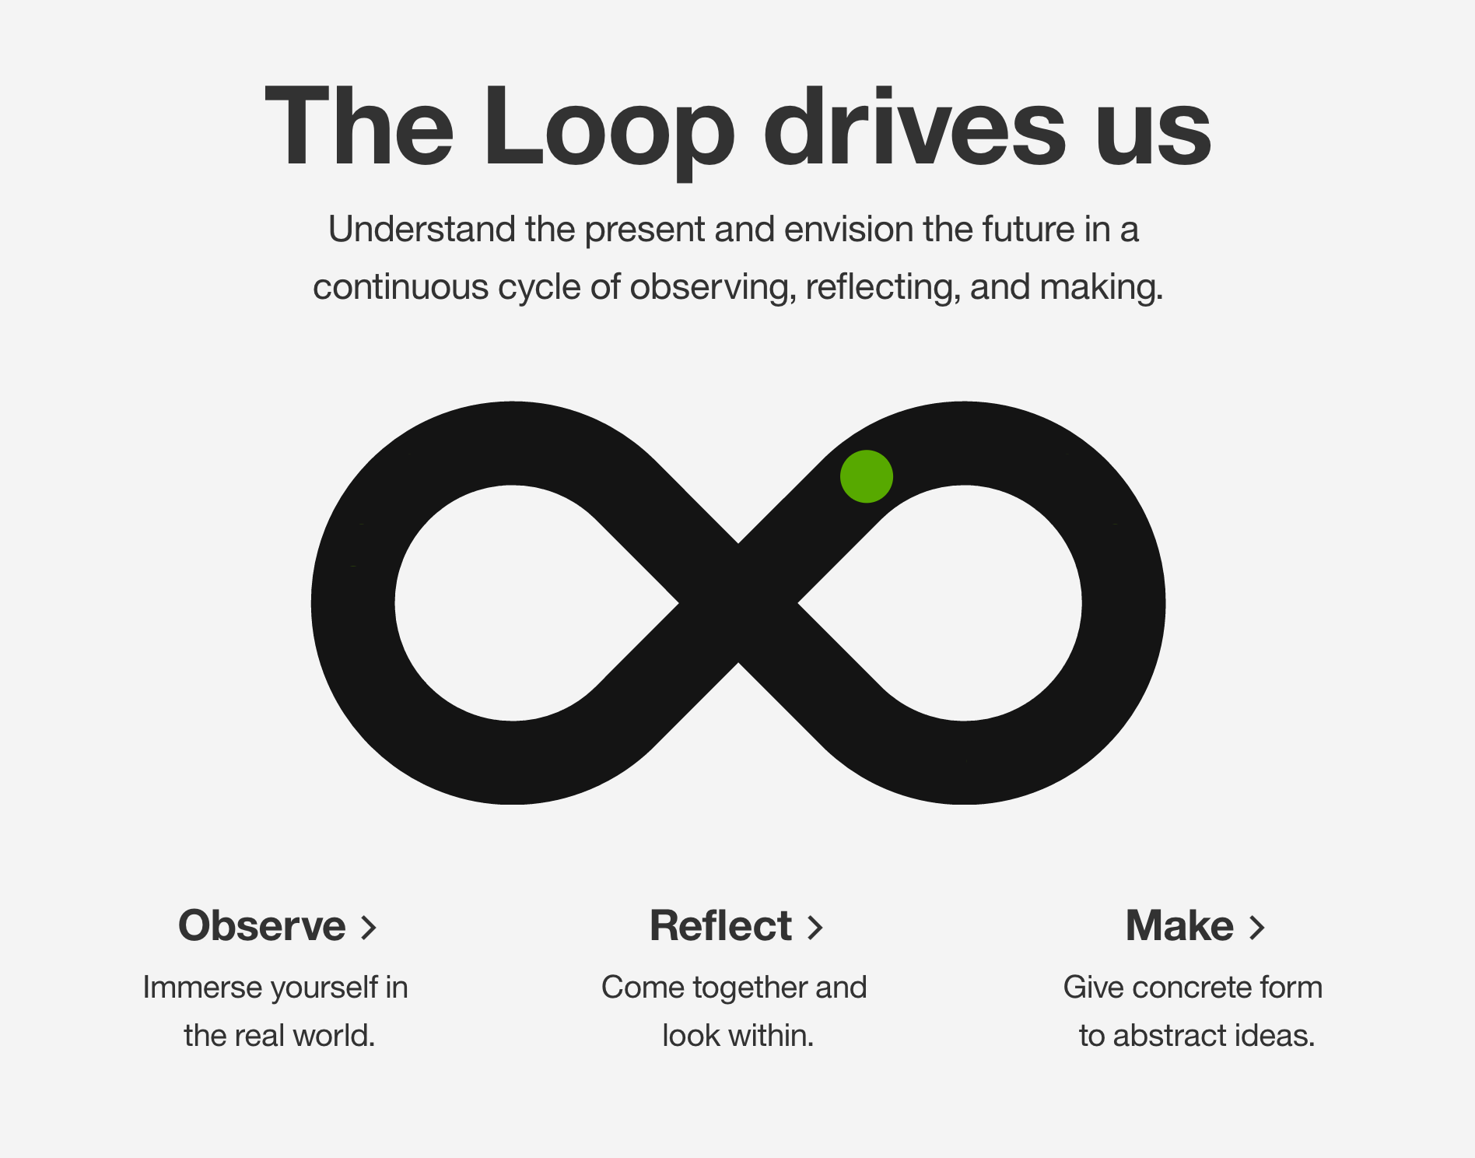
The Loop
Observe :
A precise observation of user’s needs regularly along with what other applications have missed and if we could capitalize on them
Reflect :
After the observation phase, all the information should be taken into consideration and reflected with intent. There is not an all-in-one platform, job seekers have to visit different platforms for resume review or to test their coding skills, recruiters do not get a candidate score matching the description of the job which helped us to build JobGet
Make :
Make is about taking the results of the reflecting phase and figuring out if these abstract results can be converted into intent and if they can add value

Slide 30
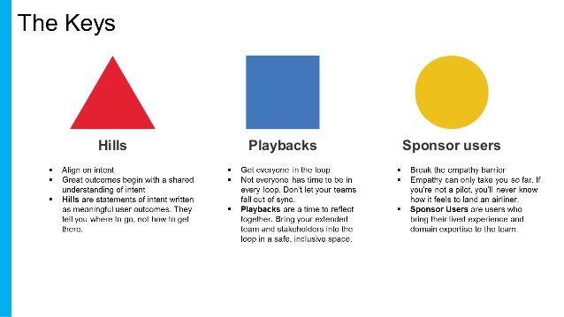
The Keys
Hills (Who, What, Wow!) :
A team or an individual is assigned a specific task or functionality and the deliverable is measured by a differentiator
Playbacks :
Playback involves conducting meetings and sessions with the team to keep a track of the development with respect to the timeline. We analyzed the codechamp model, messaging model, job seeker workflow model etc. and created a prototype
Sponsor users :
Bringing the actual user into the team and making the user an important part of building the prototype can contribute to making some important decisions on which features could be added on to JobGet, in our case we participated the users with the help of surveys

Slide 31
Style Guide

Slide 32
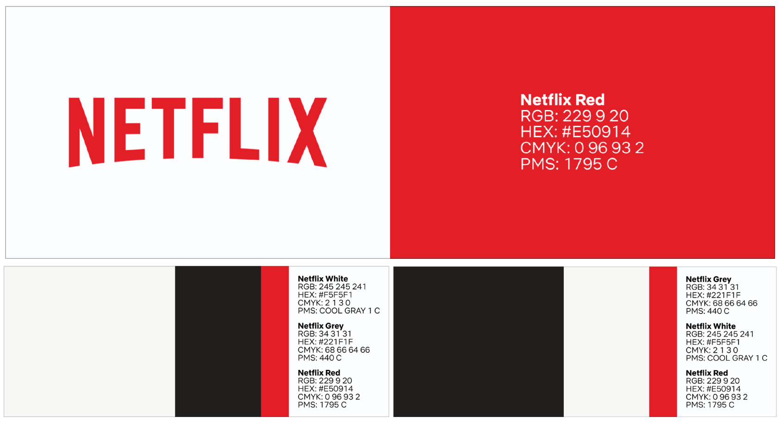
What is a Style Guide?
A style guide is a reference tool that helps maintain consistency in what a brand looks, feels and sounds like. It’s so powerful that some people even call it a brand bible - but don’t let that intimidate you, those are different names for the same document.
Using a brand style guide ensures that your brand looks and feels the same, even when you have different people working on marketing, design, sales and development.

Slide 33
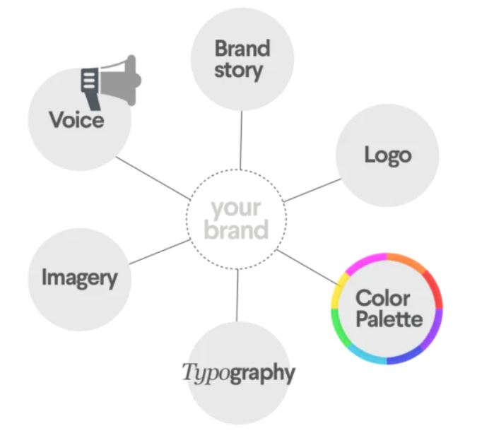
Essential Elements of a Style Guide

Slide 34
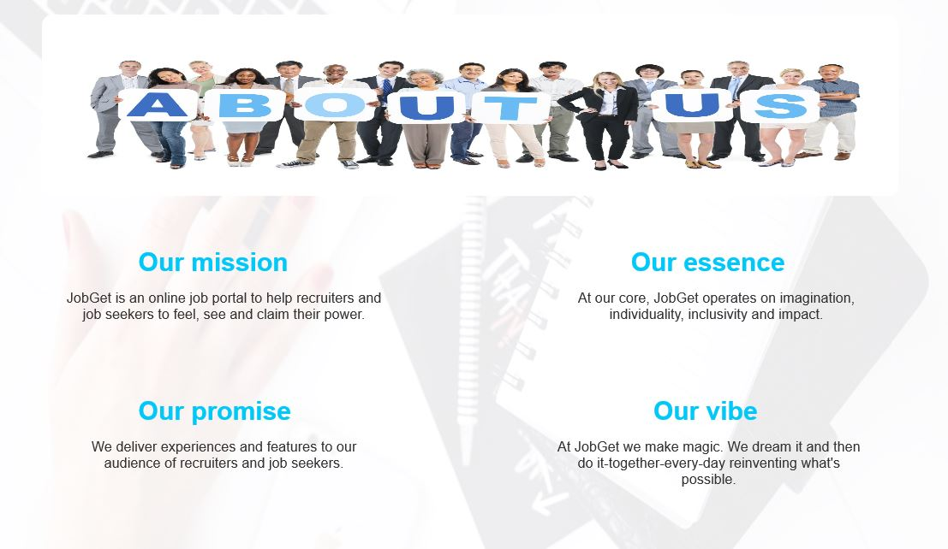
Brand Story
Introducing JobGet to the world. A simple summary will give people insight into the heart and soul of JobGet, which will help them understand how to represent JobGet.

Slide 35

Logo
JobGet’s logo is a perfect blend of the wordmark with an icon and the tagline which perfectly describes JobGet’s mission and correctly conveys it to the target audience
Including all approved versions of JobGet’s logo and describing when to use each one and showing visual examples to make it clear. Some of the logo guidelines which can be defined are logo’s size, space, colors and dont’s

Slide 36
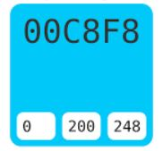
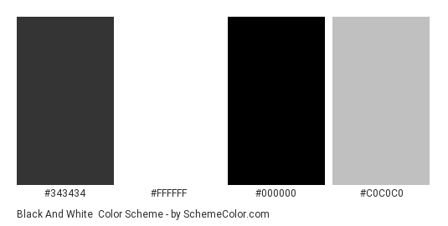
Color Palette
Defining a brand palette goes a long way towards creating a consistent look and feel. Most Brands choose 5 or fewer colors and don’t stray too far from the hues of the logo.
JobGet has done the same by making the color palette of colors in accordance with the JobGet logo and used throughout the application which provides a consistent look and feel

Slide 37
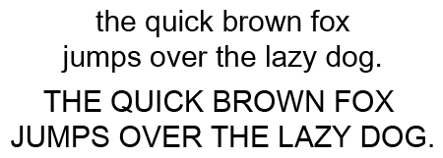
Typography
Another big part of Identity design is font selection.
We have used Arial which come from sans-serif font family. It acts neutral but is contemporary. It is clean, straight-forward and futuristic. The font-sizes used throughout are 28,24,14 and 12.
Bold and Italics are used to give emphasis to important information

Slide 38



Evolution of the brand
2012
2015
The brand style guide is a living, breathing document. You will end up learning what works as you use it, and you can always add to it or adjust the information. The most important thing is to set a solid foundation by creating one.
Designate one place to keep ideas as they come up, so you can easily find them when it’s time to review. Then calendar time to review and revisit and refresh your style guide.JobGet does this once every 3 months.
2017
2020

Slide 39
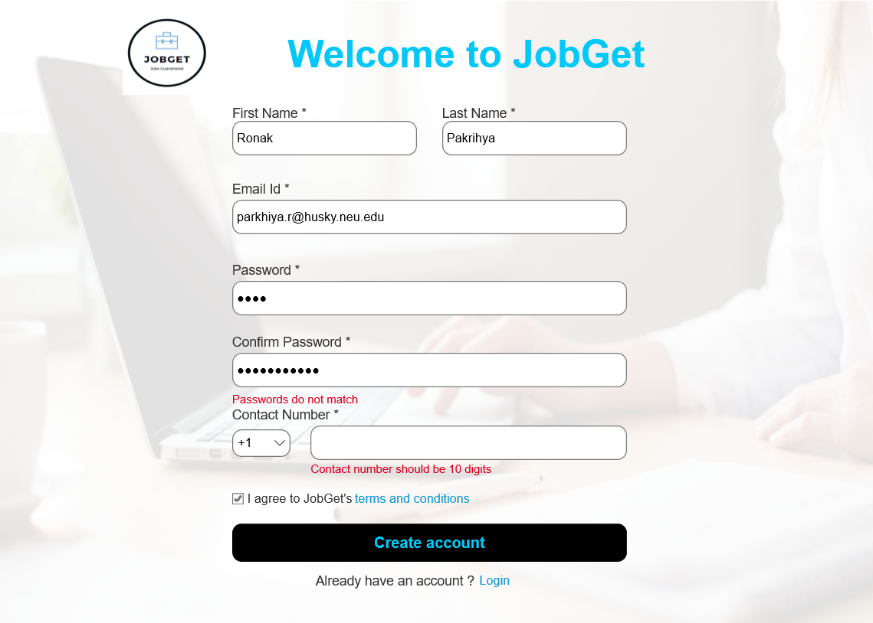
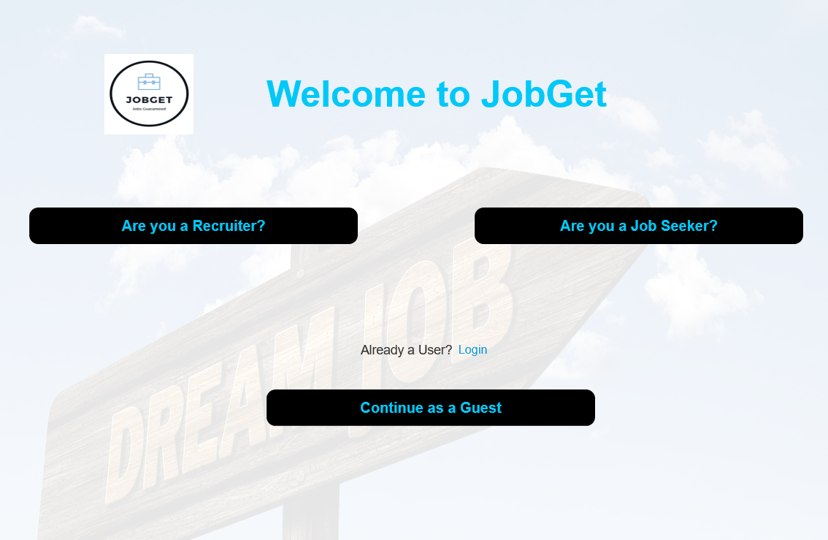
SCREENSHOTS

Slide 40
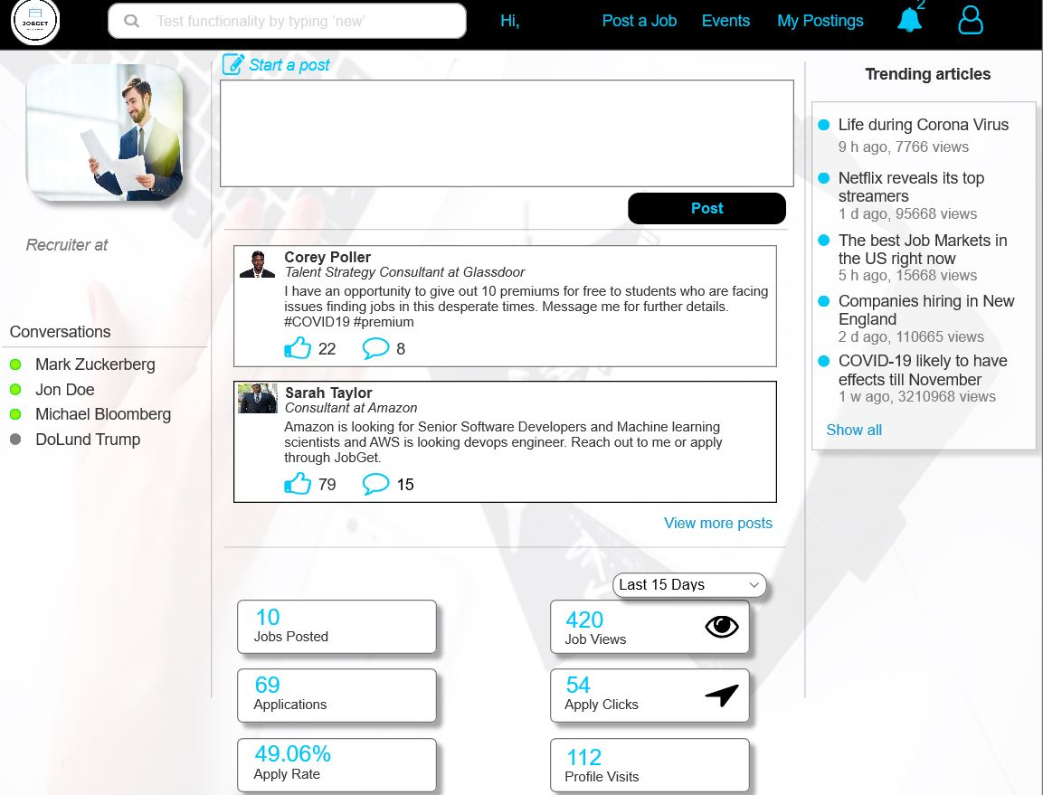
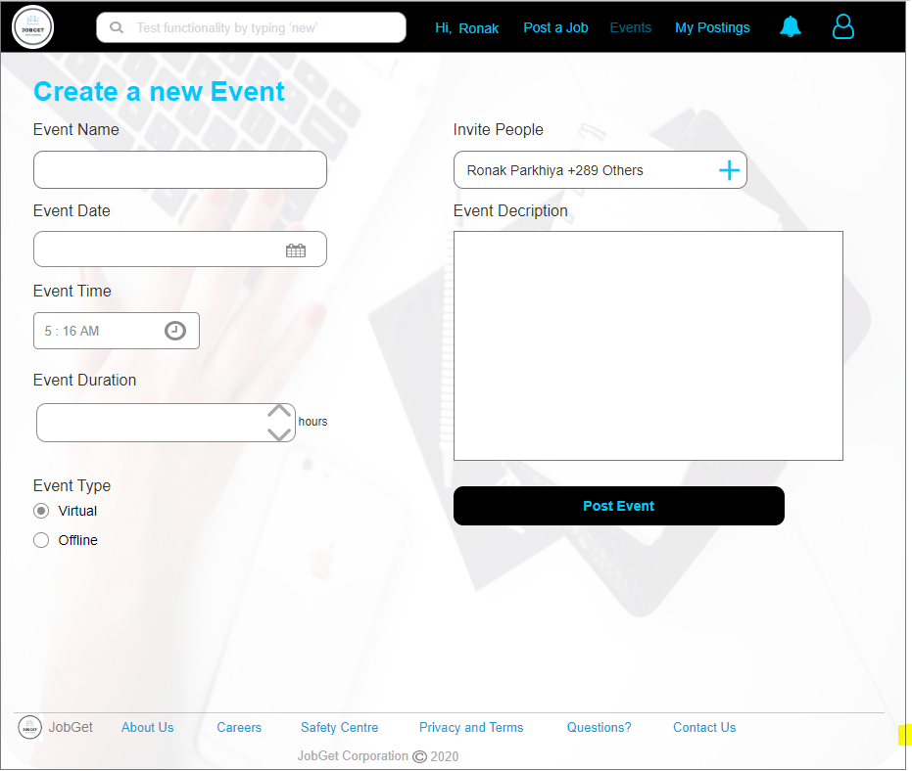
SCREENSHOTS

Slide 41
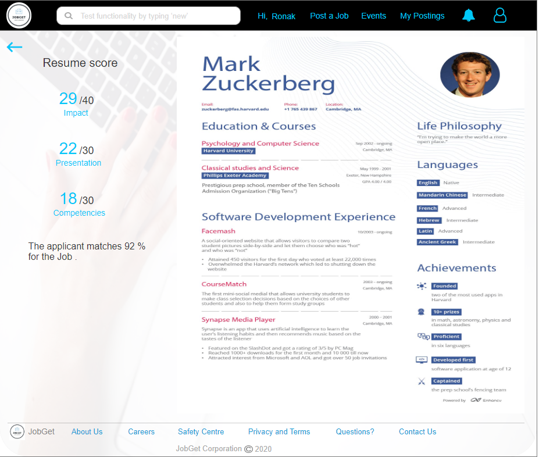
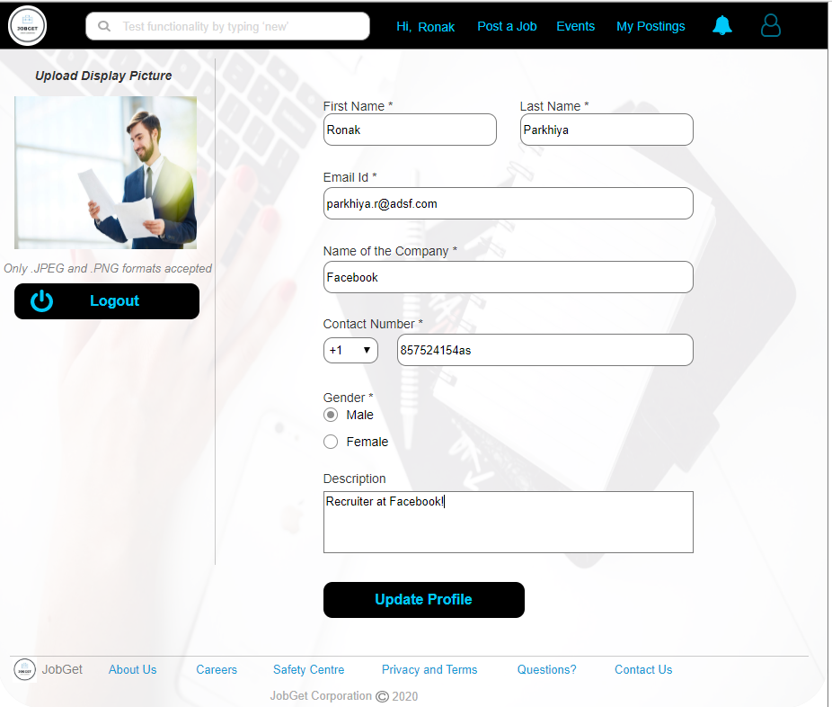
SCREENSHOTS

Slide 42
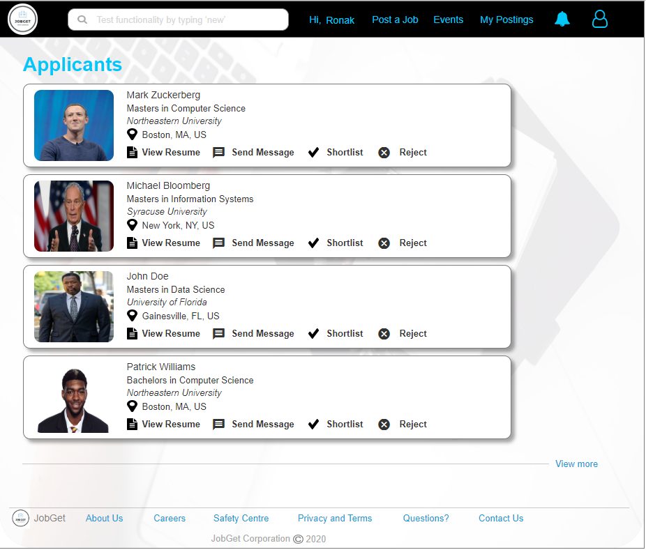
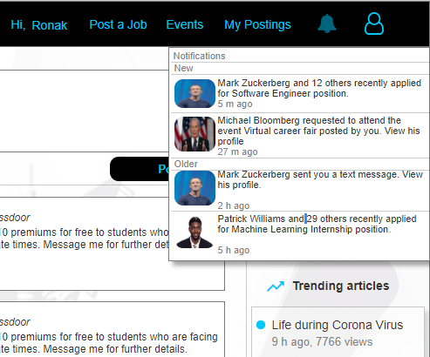
SCREENSHOTS

Slide 43
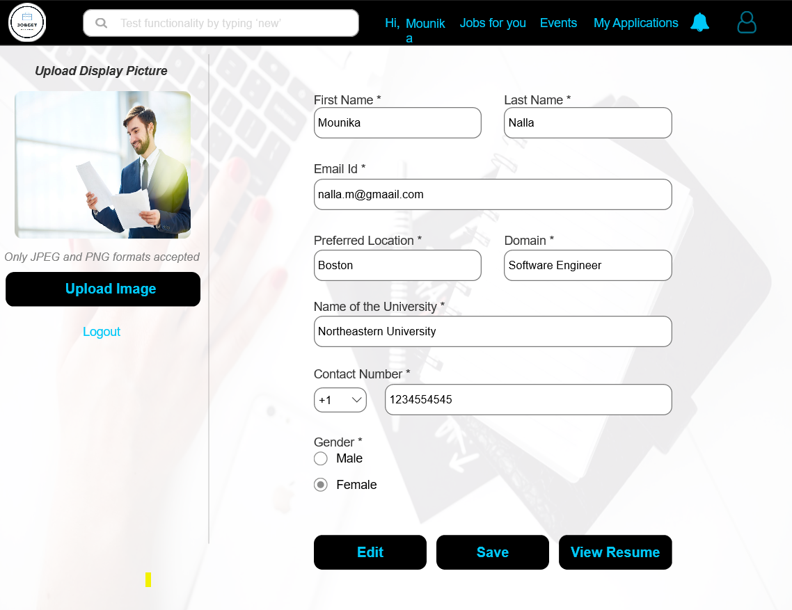
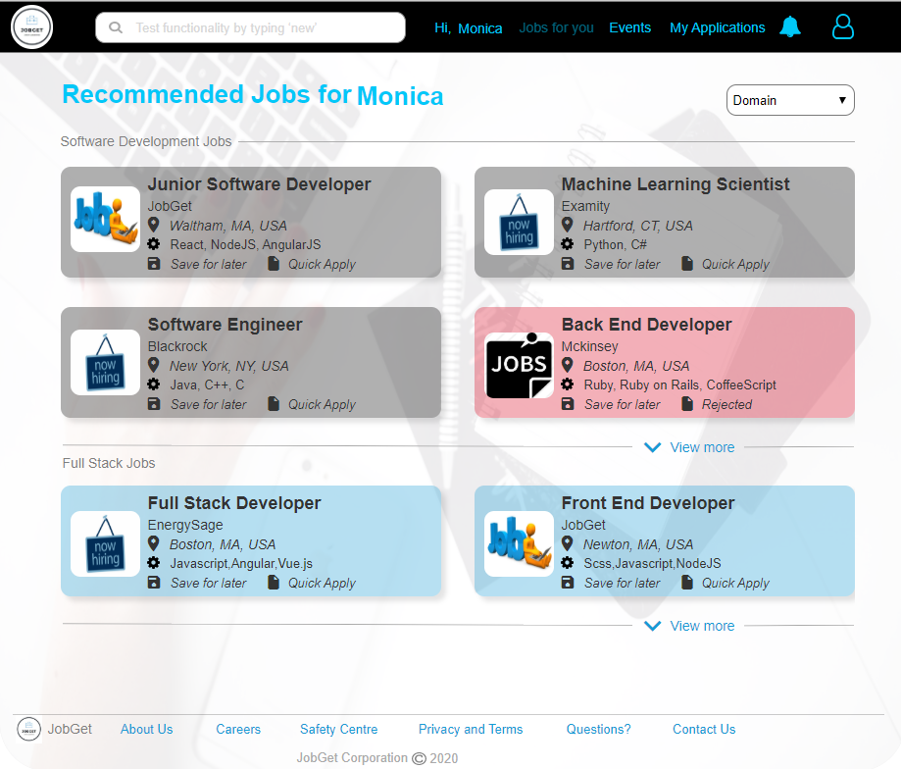
SCREENSHOTS

Slide 44
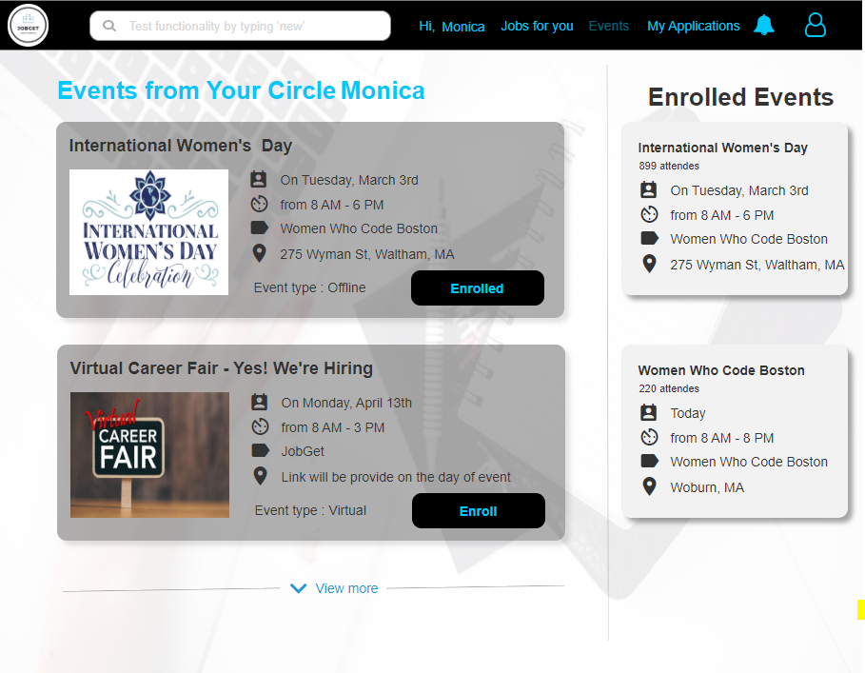
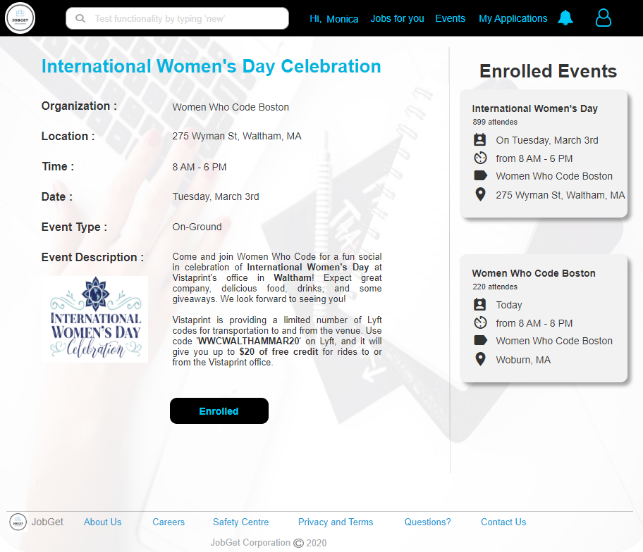
SCREENSHOTS

Slide 45
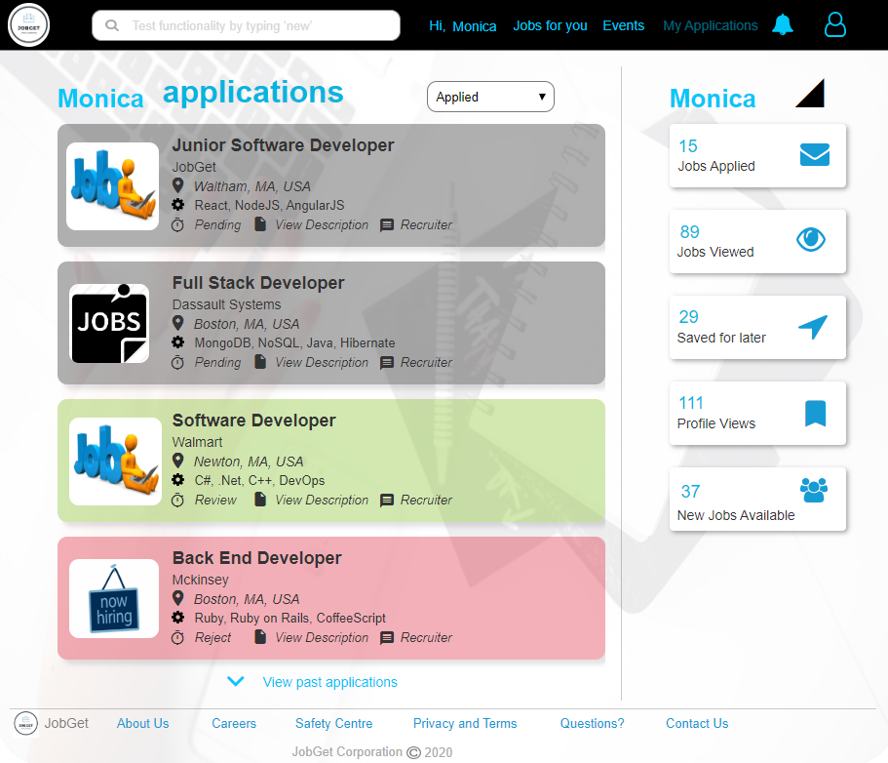
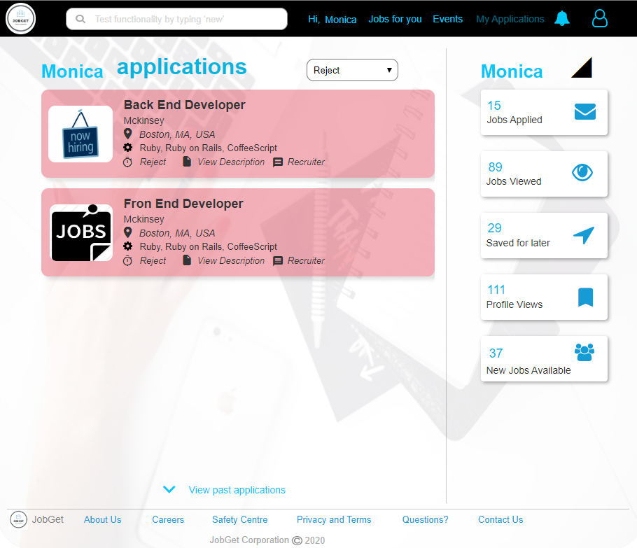
SCREENSHOTS

Slide 46
Thank you.
Harsh Shah 001400289
Ronak Parkhiya 001491072
Mounika Nalla 001063351
Ananya Yadav 001417069
Debashree 001448112
Bhattacharjee

